Slide 1
SECURING END-TO-END MESSAGING WITH ENCRYPTION
Zachary Nelson
&
Dylan Eversman

Slide 2
Agenda
Why Elliptic Curve Cryptography is so widely used.
What vulnerabilities may exist in Elliptic Curve Cryptography
How to secure implementations of Elliptic Curve Cryptography

Slide 3







The essence of Digital Cryptography
Symmetric Key
Impractical
Vulnerable to MITM
Uses same key for Encryption/Decryption
Public Key
Convenient
Secure against MITM
Uses different keys for Encryption/Decryption
3

Slide 4



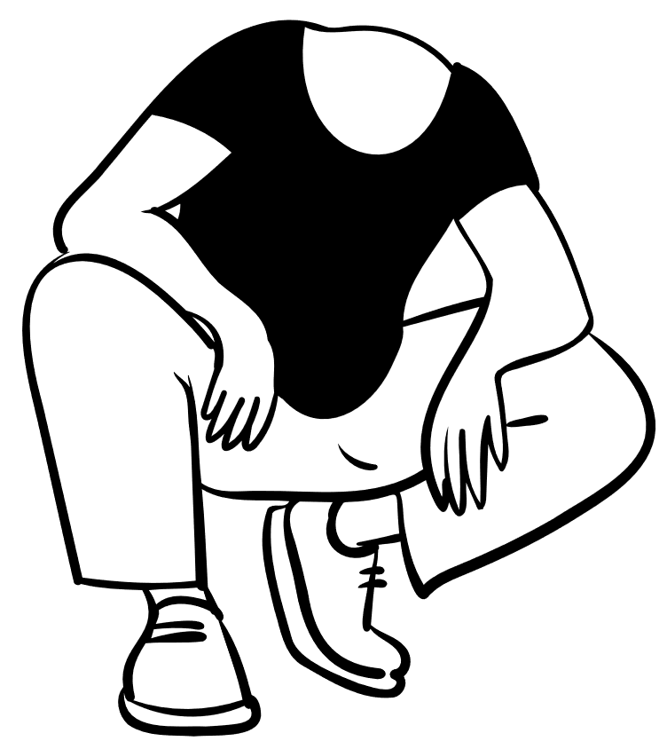



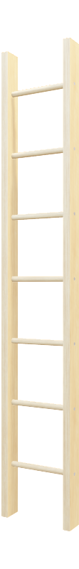
Trapdoor Functions
A function that can easily be computed but is incredibly difficult to reverse. Used as the basis for many encryption schemes such as RSA.

Slide 5

The Elliptic Curve Overview

Slide 6
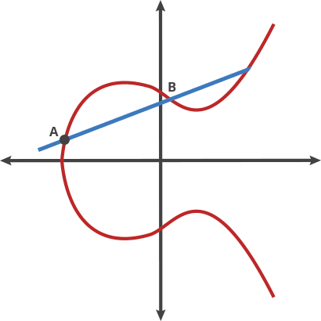
Elliptic Curves: An Introduction
An elliptic curve in the form y² = x³ + ax + b satisfies many of the conditions of Public Key Cryptography
Take any two points on the curve, connect them and dot a line below (if above the x-axis) or up (if below the x-axis).
This "dot" operation is easy to perform but difficult to reverse.
This problem, known as the discrete log problem, is an excellent trap door function.

Slide 7
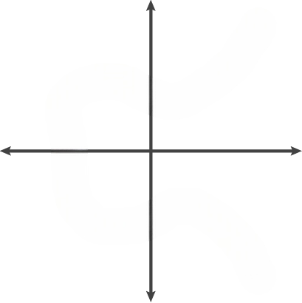
The Elliptic Solution (Cont.)
Pac-Man rules
Starting Coordinate
Public Key
Number of times to "dot" A with itself
Private Key
A
C
Maximum Size limit
Agreed upon beforehand
B
Curve
Also agreed upon beforehand

Slide 8




What Applications Use Elliptic Curves?
Signal Protocol
One of the most popular protocols for private messaging is Signal. The protocol is used in applications such as WhatsApp, Signal, Facebook Messenger, Google Messenger, and more.
The protocol uses the Elliptic Curve Cryptography standard: Curve 25519. This standard is approved by the National Institute of Standards and Technology; and is incredibly fast.

Slide 9



Not so fun fact
fun fact!
- Cracking encryption requires energy
- Energy can be used to boil water
- What do the comparisons look like?
RSA 242 (Basic) = Teaspoon of water
RSA 745 (Advanced) = Olympic swimming pool
RSA 3072 (ECC Standard) = All of the water on Earth
(Lenstra et al., 1970)

Slide 10
Elliptic Curve vulnerabilities

Slide 11
These curves don’t lie(… or do they?)
In 2006 Dual_EC_DRBG – A Pseudo random number generator using EC -was approved for use by the National Institute of Standards and Technology.
In 2007 an article on a potential backdoor within the system is published in Wired. With unknown values, it may be possible to break the encryption.
In 2013 The New York Times reported the NSA was a major contributor to the standard, and may have inserted a backdoor
In 2014 NIST recommends other cryptographic standards be used.

Slide 12
Additional vulnerabilities
Issues with Elliptic curve standards persist today. Curve 25519 and curves in the same family may be vulnerable to attacks.
Not verifying response in communication can lead to an invalid curve attack. By altering the value of b in the equation y² = x³ + ax + b to that of a known curve, an attacker may eventually discover a private key.
By failing to validate responses contain points within a valid subgroup of points could lead to a small subgroup attack. An attacker may eventually gain a private key by reducing the problem difficulty.

Slide 13

Securing ECC encryption

Slide 14
A more Secure Standard
To avoid potential vulnerabilities such as the small subgroup attack, we sought out an elliptic curve standard that follows secure-by-design standards.
The Double-Odd family of elliptic curves prevents subgroup attacks by defining a prime order over their subgroups.
All operations are approximately constant-time implementations.
This leads to secure, fast operations that are needed in applications using end-to-encryption.

Slide 15

Okay, So what?
HOLD
UP!!!
Real World Applications:
Email Security
Financial transaction security
Digital Signatures
Bitcoin
Secure Chatroom Messaging
Secure Chatroom Messaging???

Slide 16
It is time for… A demonstration

Slide 17
Future Improvements
GUI implementation
User Accounts
Ability to send images or files

Slide 18
THANK YOU
Hopefully you learned something
Zachary Nelson
&
Dylan Eversman

Slide 19
References​
Lenstra, A. K., Kleinjung, T., & Thomé, E. (1970, January 1). Universal security; from bits and MIPS to pools, lakes -- and beyond. Cryptology ePrint Archive. https://eprint.iacr.org/2013/635
Sullivan, N., Kwiatkowski, K., Faz-Hernández, A., Grant, D., Krasnov, V., & Graham-Cumming, J. (2023, October 24). A (relatively easy to understand) primer on elliptic curve cryptography. The Cloudflare Blog. https://blog.cloudflare.com/a-relatively-easy- to-understand-primer-on-elliptic-curve- cryptography
Pornin, T. (n.d.). Double-Odd Elliptic Curves. https://doubleodd.group/front.html
Bottinelli, P. (2023, June 30). An illustrated guide to elliptic curve cryptography validation. NCC Group Research Blog. https://research.nccgroup.com/2021/11/18/an-illustrated-guide-to-elliptic- curvecryptography-validation/

